Slide 1
DISTRIBUTED
OPERATING
SYSTEM

Slide 2
DISTRIBUTED SYSTEM
A distributed system is a collection of autonomous computers that appear to the users of the system as a single computer.

Slide 3
Why Distributed Systems?
Resource sharing
Scalability
Reliability
Need for higher processing speed
Spatial distribution is inherent in many applications

Slide 4
DISTRIBUTED COMPUTING
Microelectronic technology have resulted in the availability of fast and inexpensive processors.
Communication technology have resulted in cost-effective and highly efficient computer networks.
Computer architectures consisting of interconnected, multiple processors are of two types:
Tightly coupled systems.
Loosely coupled systems.

Slide 5
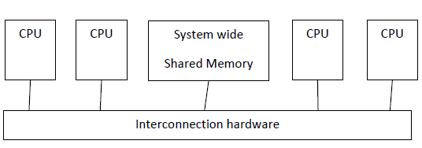
Tightly Coupled Systems
(parallel processing systems )
Single system wide primary memory is shared by all the processors.
Communication between the processors takes place through the shared memory.

Slide 6
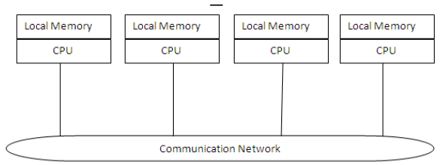
Loosely Coupled Systems
(distributed computing systems )
The processors do not share memory
Each processor has its own local memory.
Communication between the processors is done by message passing.

Slide 7
Processors of loosely coupled systems can be located far from each other to cover a wider geographical area.
In tightly coupled systems,
number of processors usefully deployed is small and
limited by the bandwidth of the shared memory.
This is not the case with distributed computing systems.
Distributed computing systems are more freely expandable
Can have almost unlimited number of processors.
Its own resources are local, whereas the other processors and their resources are remote.
Together, a processor and its resources are called node/site/machine of the distributed computing system.

Slide 8
TIME-SHARING SYSTEMS
In 1970s that computers started to use the concept of time sharing.
The advent of time-sharing systems was the first step toward distributed computing systems.
It provided with two important concepts used in distributed computing systems
the sharing of computer resources simultaneously by many users,
accessing of computers from a place different from the main computer room.

Slide 9
Centralized Time-Sharing Systems
Processing of a user's job was done at the user's own computer.
Main computer was simultaneously shared by a larger number of users.
Shared resources such as files, databases, and software libraries were placed on the main computer.
Limitation: terminals could not be placed very far from the main computer room as ordinary cables were used to connect the terminals to the main computer.

Slide 10
Evolution of Distributed Computing Systems
Between 1960s and early 1970s emerged two key networking technologies the LAN (local area network) and WAN (wide area network).
In 1990’s there was advancement in networking technology, the ATM (Asynchronous Transfer Mode) technology.
ATM’s can make very high speed networking possible, in both LAN and WAN environments.
The availability of high-bandwidth networks can allow distributed computing systems to support multimedia applications.
The merging of computer and networking technologies gave birth to distributed computing systems in the late 1970s.

Slide 11
MODELS OF DISTRIBUTED COMPUTING SYSTEM
Minicomputer
Workstation
Workstation-server
Processor-pool
Hybrid

Slide 12
Minicomputer Model
Is an extension of the centralized time-sharing system
Consists of a few minicomputers interconnected by a communication network.
Each minicomputer has multiple users simultaneously logged on to it.
Each user is logged on to one specific minicomputer, with remote access to other minicomputers.
The network allows a user to access remote resources that are available on some other machines.
Used when resource sharing with remote users is desired.

Slide 13
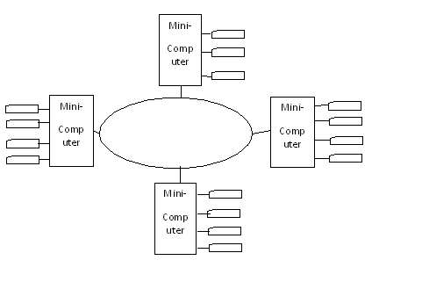
Distributed computing system based on the minicomputer model

Slide 14
Workstation Model
It consists of several workstations interconnected by a communication network.
Each workstation is equipped with its own disk and serve as a single-user computer.
Limitation: At any one time a significant proportion of the workstations are idle resulting in the waste of CPU time.
The idea of the workstation model is to interconnect all these workstations by a high-speed LAN so that idle workstations may be used to process jobs of following users: -
who are logged onto other workstations and
Who do not have sufficient processing power at their own workstations to get their jobs processed efficiently.
In this model:
a user logs onto one of the workstations called "home” workstation
submits jobs for execution.
When the system finds that the user's workstation does not have sufficient processing power for executing the processes of the submitted jobs efficiently,
it transfers one or more of the processes from the user's workstation to some other workstation that is currently idle and gets the process executed there,
the result of execution is returned to the user's workstation.

Slide 15
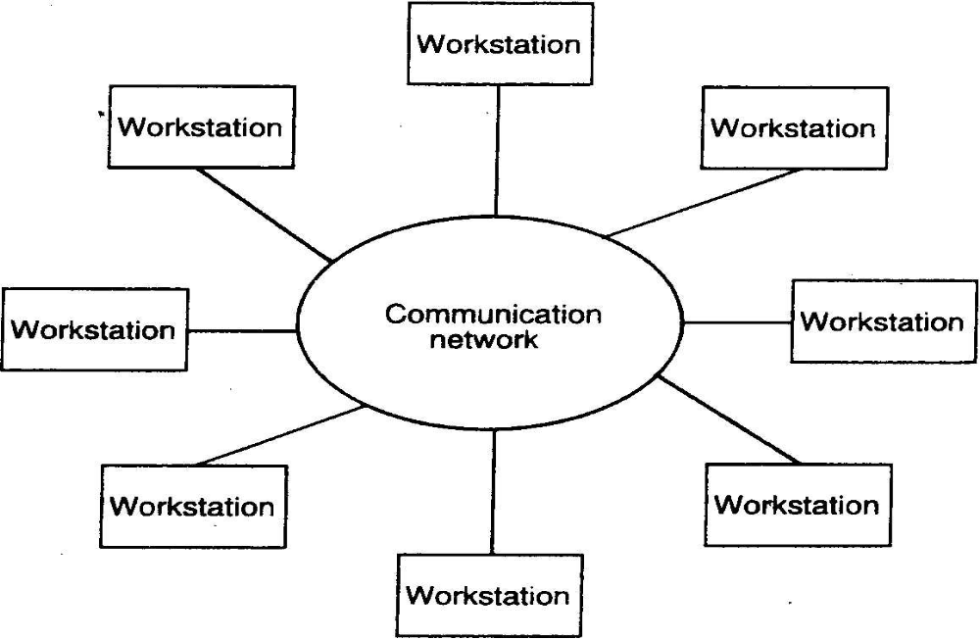
Distributed computing system based on the workstation model

Slide 16
Limitations of Workstation Model
This model is not so simple to implement due to issues like: -
How does the system find an idle workstation?
How is a process transferred from one workstation to get it executed on another workstation?
3. What happens to a remote process if a user logs onto a workstation that was idle until now and was being used to execute a process of another workstation?

Slide 17
Workstation-Server Model
It is a network of personal workstations, each with its own disk and a local file system.
A workstation with its own local disk is called a diskful workstation.
A workstation without a local disk is called a diskless workstation.

Slide 18
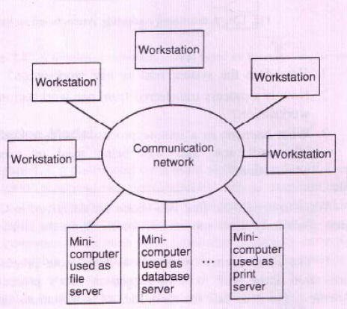
Distributed computing system based on the workstation server model

Slide 19
It consists of a few minicomputers and several workstations interconnected by a communication network.
Minicomputers are used for implementing the file system and other for providing other types of services, such as database service and print service.
There are specialized machines (or the specialized workstations) for running server processes for managing and providing access to shared resources.
For higher reliability and better scalability, multiple servers are used for managing the resources of a particular type in a distributed computing system.

Slide 20
ADVANTAGES OF WORKSTATION-SERVER MODEL
It is cheaper to use a few minicomputers equipped with large, fast disks that are accessed over the network than a large number of diskful workstations,with each workstation having a small, slow disk.
Diskless workstations are also preferred to diskful workstations from a system maintenance point of view. (Backup and hardware maintenance are easier).
All files are managed by the file servers, so users have the flexibility to use any workstation and access the files in the same manner irrespective of which workstation the user is currently logged on.
The request-response protocol is used to access the services of the server machines.
A user has guaranteed response time because workstations are not used for executing remote processes.
LIMITATION: the model does not utilize the processing capability of idle workstations.

Slide 21
Request-Response Protocol
Also known as the client-server model of communication.
A client process sends a request to a server process for getting some service such as reading a block of a file.
The server executes the request and sends back a reply to the client that contains the result of request processing.
Provides effective general-purpose approach to the sharing of information and resources in distributed computing systems.
It is possible for both the client and server processes to be run on the same computer.
Some processes are both client and server processes. (a server process may use the services of another server, appearing as a client to the latter).

Slide 22
Processor-Pool Model
It is based on the observation that most of the time a user does not need any computing power but once in a while user may need a very large amount of computing power for a short time
In workstation-server model a processor is allocated to each user.
In the processor pool model the processors are pooled together to be shared by the users as needed.
The pool of processors consists of a large number of microcomputers and minicomputers attached to the network.
Each processor in the pool has its own memory to load and run a system program or an application program of the distributed computing system.

Slide 23
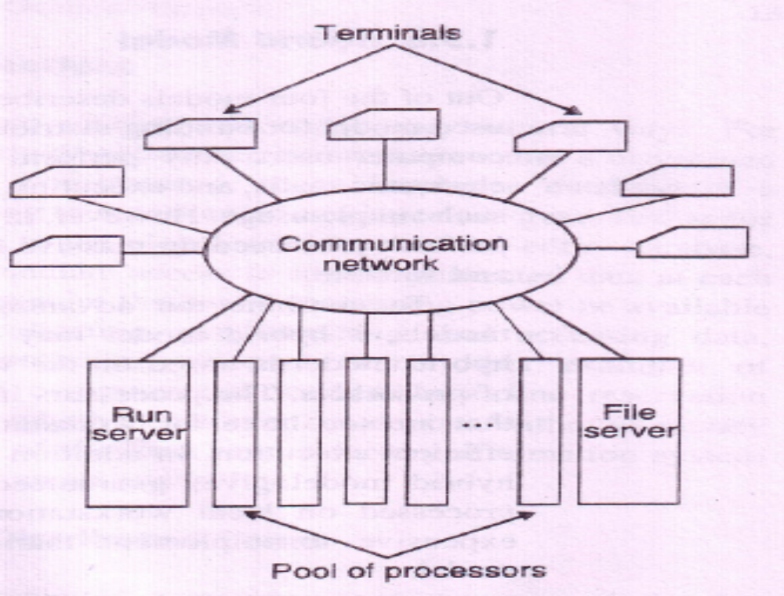
Distributed computing system based on processor-pool model

Slide 24
Comparison of Processor-Pool Model with workstation-server model
1. Allows better utilization of the available processing power of a distributed computing system, as entire processing power of the system is available for use by the currently logged-on users,
(whereas in the workstation-server model several workstations may be idle at a particular time but they cannot be used for processing the jobs of other users. )
2. Provides greater flexibility than the workstation-server model as the system's services can be easily expanded without the need to install any more computers.
(the processors in the pool can be allocated to act as extra servers to carry any additional load arising from an increased user population or to provide new services.)
Limitation: Is usually not suitable for high performance interactive applications, especially using graphics or window systems.
(This is due to the slow speed of communication between the computer on which the application program of a user is being executed and the terminal via which the user is interacting with the system. The workstation-server model is considered more suitable for such applications).

Slide 25
Hybrid Model
Combine the advantages of both the workstation-server and processor-pool models.
Is based on the workstation-server model with the addition of a pool of processors.
The processors in the pool can be allocated dynamically for computations:
that are too large for workstations or
that require several computers concurrently.
Gives guaranteed response to interactive jobs by allowing them to be processed on local workstations of the users.
Limitation: More expensive to implement than the workstation-server model or the processor-pool model.

Slide 26
Limitations of Distributed Computing Systems
Distributed computing systems are complex and difficult to build than traditional centralized systems.
Complexity is mainly due to:
Using and managing a very large number of distributed resources,
Handling the communication and security problems
The performance and reliability of a distributed computing system depends on the performance and reliability of the communication network.
Special software is needed to handle loss of messages or to prevent overloading of the network, which degrades the performance and responsiveness to the users.
Special software security measures are needed to protect the widely distributed shared resources and services against intentional or accidental violation of access control and privacy constraints.

Slide 27
Advantages of
Distributed Computing Systems
Despite the increased complexity and the difficulty of building distributed computing systems, the installation and use of distributed computing systems is increased.
The technical needs, the economic pressures, and the major advantages that have led to the emergence and popularity of distributed computing systems
………….contd

Slide 28
Inherently Distributed Applications
Several applications are inherently distributed in nature and require a distributed computing system for their realization.
Examples: airline reservation system, banking system and a factory automation system controlling robots and machines all along an assembly line.
These applications require that some processing power be available at many distributed locations for
collecting,
preprocessing and
accessing data.

Slide 29
Information Sharing among Distributed Users
Desire for efficient person-to-person communication facility by sharing information over great distances was reason for the emergence of distributed computing systems
The use of distributed computing systems by a group of users to work cooperatively is known as Computer-Supported Cooperative Working (CSCW), or Groupware.
Groupware applications depend on the sharing of data objects between programs running on different nodes of a distributed computing system.

Slide 30
RESOURCE SHARING
Sharing of software resources (such as software libraries, databases, hardware resources) can be done in a very effective way among all the computers and the users of a single distributed computing system.

Slide 31
Better Price-Performance Ratio
With increasing power
With reduction in the price of microprocessors
With the increasing speed of communication networks
distributed computing systems have a much better price-
performance ratio than a single large centralized system.
Small number of CPUs based on the processor-pool model can be used by a large number of users from inexpensive terminals, giving a high price-performance ratio as compared to either a centralized time-sharing system or a personal computer.
They also facilitate resource sharing among multiple computers.

Slide 32
Shorter Response Times and Higher Throughput
Multiple processors can be utilized properly for providing shorter response times and higher throughput than a single-processor centralized system.
If a particular computation can be partitioned into a number of subcomputations that can run concurrently, in a distributed computing system all the subcomputations can be simultaneously run with each one on a different processor.

Slide 33
Higher Reliability
Reliability refers to the degree of tolerance against errors and component failures in a system.
Multiplicity of storage devices and processors allows the maintenance of multiple copies of critical information within the system.
Execution of important computations redundantly protect them against catastrophic failures.
If one of the processors fails, the computation can be successfully completed at the other processor,
If one of the storage devices fails, the information can be used from the other storage device.
The geographical distribution of the processors and other resources in a limits the scope of failures caused by natural disasters.
Availability, refers to the fraction of lime for which a system is available for use. In comparison to a centralized system, a distributed computing system enjoys the advantage of increased availability.

Slide 34
Extensibility and Incremental Growth
Distributed computing systems are capable of incremental growth.
Example: gradually extend the power and functionality of a distributed computing system by adding additional resources (both hardware and software) to the system as and when the need arises.
Incremental growth is a very attractive feature for applications where it is practically impossible to predict future demands of the system.
Extensibility is also easier in a distributed computing system (addition of new resources to an existing system can be performed without significant disruption of the normal functioning of the system).
Properly designed distributed computing systems that have the property of extensibility and incremental growth are called open distributed systems.

Slide 35
Better Flexibility in Meeting Users' Needs
Different types of computers are suitable for performing different types of computations.
Example, computers with ordinary power are suitable for ordinary data processing jobs, whereas high-performance computers are more suitable for complex mathematical computations.
A distributed computing system have a pool of different types of computers.
Most appropriate one can be selected for processing a user's job depending on the nature of the job.
Example: in a distributed computing system based on the hybrid model, interactive jobs can be processed at a user's own workstation and the processors in the pool may be used to process non-interactive, computation-intensive jobs.

Slide 36
INTRODUCTION
The operating systems used for Distributed Computing Systems (DCS) is classified into two Network Operating Systems (NOS) and Distributed Operating Systems (DOS).
Difference between NOS and DOS:
In a NOS the users view the DCS as a collection of distinct machines connected by a communication subsystem. The users are aware that multiple computers are being used.
A DOS hides the existence of multiple computers and provides a single-system image to its users. It makes a collection of networked machines act as a virtual uniprocessor.
In NOS each computer of the DCS has its own local operating system and there is no coordination at all among the computers except for the rule that when two processes of different computers communicate with each other they must use a mutually agreed on communication protocol.
While with a DOS there is a single system wide operating system and each computer of the DCS runs a part of this global operating system.
Fault tolerance capability of a DOS is usually very high as compared to that of a NOS.

Slide 37
What is
Distributed Operating Systems (DOS)?
A distributed operating system is one that looks to its users like an ordinary centralized operating system but runs on multiple, independent CPUs.
The key concept is transparency (the use of multiple processors should be invisible (transparent) to the user).
A distributed computing system that uses a network operating system is referred as a NETWORK SYSTEM, and one that uses a distributed operating system is referred as a TRUE DISTRIBUTED SYSTEM.

Slide 38
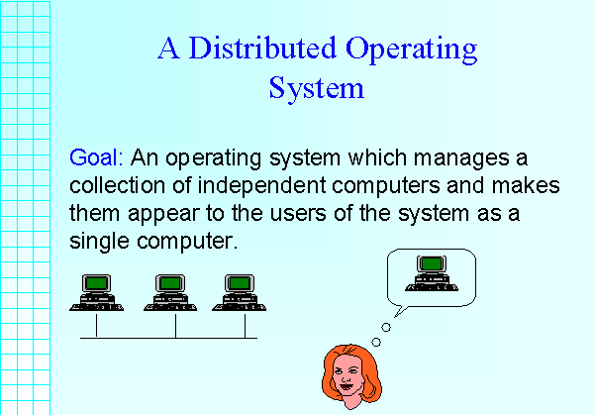

Slide 39
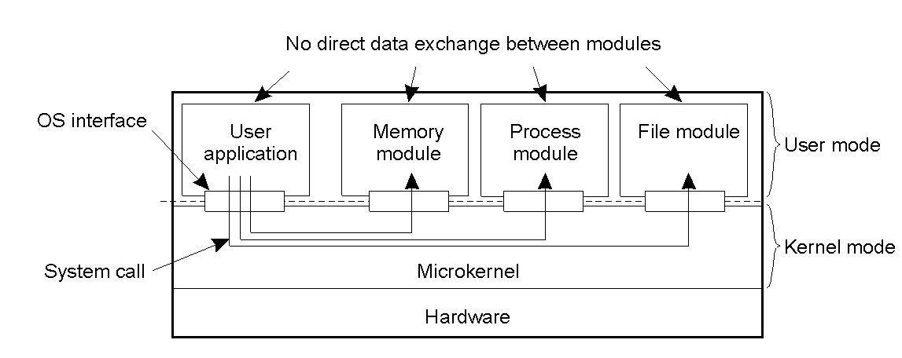
Uniprocessor Operating Systems

Slide 40
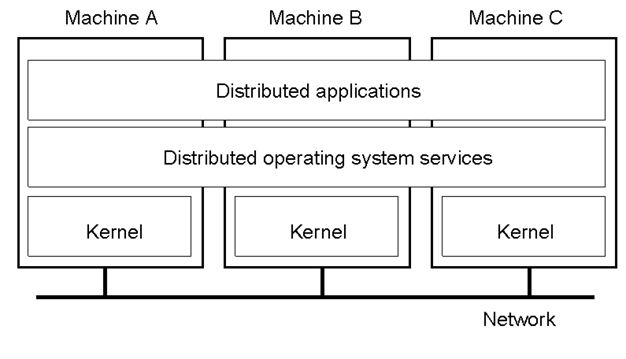
Multicomputer Operating Systems

Slide 41
MESSAGE PASSING IN DOS
Each computer have a resource manager process to monitor the current status of usage of its local resources.
Resource managers of all the computers communicate with each other to dynamically balance the system load among all the computers.
Distributed Operating System provide Inter-Process Communication (IPC) mechanisms to facilitate such communication.

Slide 42

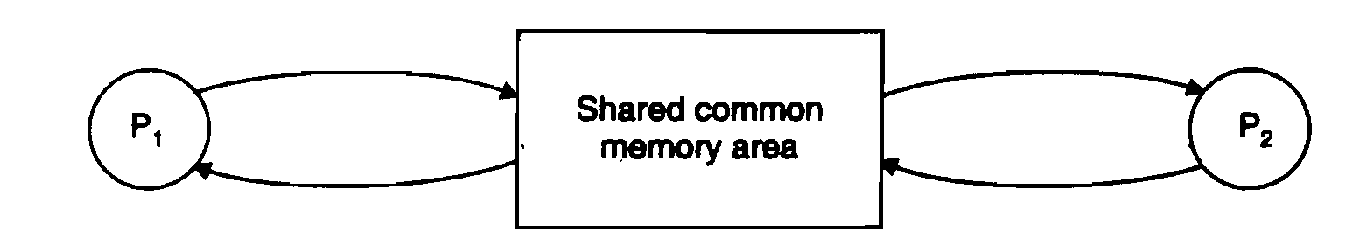
Inter-Process Communication (IPC) methods
Shared-data approach
Message-passing approach.

Slide 43
Message-passing
Provides a set of message-based IPC protocols.
Shields the details of complex network protocols and multiple heterogeneous platforms from programmers.
It enables processes to communicate by exchanging messages.
It allows programs to be written by using simple communication primitives, such as send and receive.
It serves as a suitable infrastructure for building other higher level IPC systems, such as Remote Procedure Call (RPC) and Distributed Shared Memory (DSM)

Slide 44
DESIRABLE FEATURES OF A GOOD MESSAGE PASSING SYSTEM
Simplicity
(Clean and simple semantics of the IPC protocols.)
Uniform Semantics
(Semantics of remote communications should be as close as possible to those of local communications.)
Efficiency
(*Reducing the number of message exchanges during the communication process.
*Optimizations adopted for efficiency.)
Reliability
(*Cope with failure problems and guarantees the delivery of a message.
*Acknowledgments and retransmissions on the basis of timeouts.
*Duplicate messages may be sent in the event of failures or because of timeouts.)

Slide 45
Correctness
(*Atomicity ensures that every message sent to a group of receivers will be delivered to either all of them or none of them.
*Ordered delivery ensures that messages arrive at all receivers in an order acceptable to the application.
*Survivability guarantees that messages will be delivered correctly despite partial failures of processes, machines, or communication links.)
Flexibility
(IPC primitives must have the flexibility to permit any kind of control flow between the cooperating processes.)
Security
(*Authentication of the Receiver/Sender of a message by the Sender/Receiver;
*Encryption of a message before sending it over the network).
Portability
(*Easily construct a new IPC facility on another system by reusing the basic design of the existing message-passing system.
*The applications written by using the primitives of the IPC protocols of the message-passing system should be portable.)

Slide 46
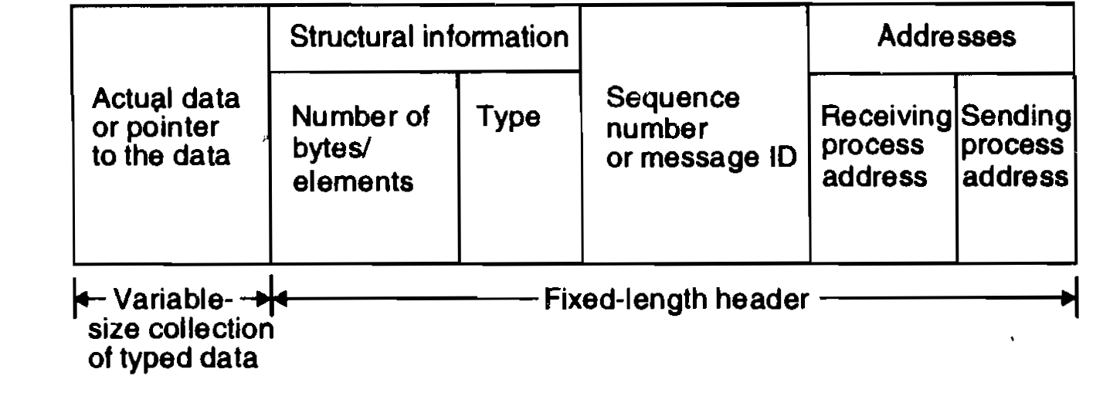
Message is a block of information.

Slide 47
IMPORTANT ISSUES NEED TO BE CONSIDERED IN THE DESIGN OF IPC PROTOCOL
Who is the sender?
Who is the receiver?
Is there one receiver or many receivers?
Is the message guaranteed to have been accepted by its receiver(s)?
Does the sender need to wait for a reply?
What should be done if a catastrophic event such as a node crash or a communication link failure occurs during the course of communication?
What should be done if the receiver is not ready to accept the message: Will the message be discarded or stored in a buffer? In the case of buffering, what should be done if the buffer is full?
If there are several outstanding messages for a receiver, can it choose the order in which to service the outstanding messages?

Slide 48
SYNCHRONIZATION
The semantics used are blocking and nonblocking types.
Depends on one of the two types of semantics used for the send and receive primitives.
In blocking send primitive, after execution of the send statement, the sending process is blocked until it receives an acknowledgment from the receiver that the message has been received.
For nonblocking send primitive, after execution of the send statement, the sending process is allowed to proceed with its execution as soon as the message has been copied to a buffer.
In blocking receive primitive, after execution of the receive statement, the receiving process is blocked until it receives a message.
For a nonblocking receive primitive, the receiving process proceeds with its execution after execution of the receive statement, which returns control almost immediately just after telling the kernel where the message buffer is.

Slide 49
How receiving process knows that message has arrived in the message buffer in a nonblocking receive primitive?
Polling. A test primitive is provided to allow the receiver to check the buffer status.
The receiver uses this primitive to periodically poll the kernel to check if the message is already available in the buffer.
Interrupt. When the message has been filled in the buffer and is ready for use by the receiver, a software interrupt is used to notify the receiving process.
This method is efficient but user-level interrupts make programming difficult .

Slide 50
Synchronous Communication
When both the send and receive primitives of a communication between two processes use blocking semantics, the communication is said synchronous; otherwise it is asynchronous.
The sending process sends a message to the receiving process, then waits for an acknowledgment.
After executing the receive statement, the receiver remains blocked until it receives the message sent by the sender.
On receiving the message, the receiver sends an acknowledgment message to the sender.
The sender resumes execution only after receiving this acknowledgment message.

Slide 51
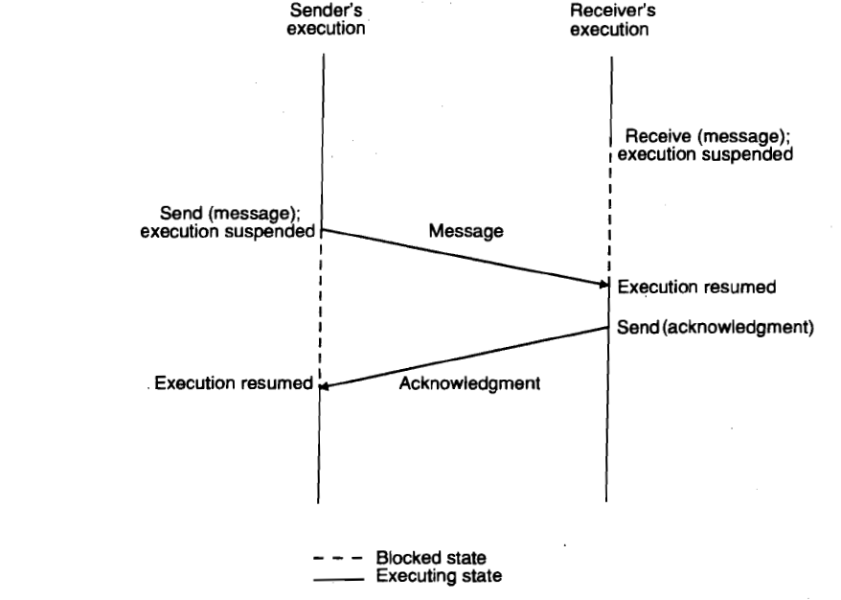

Slide 52
Advantages:
Compared to asynchronous communication, synchronous communication is simple and easy to implement.
Is reliable, as it assures the sending process that its message has been accepted before the sending process resumes execution.
If the message gets lost or is undelivered, no backward error recovery is necessary for the sending process to establish a consistent state and resume execution.
Drawbacks:
Limits concurrency and
Subject to communication deadlocks.
Less flexible than asynchronous communication (sending process always has to wait for an acknowledgment from the receiving process even when this is not necessary.)

Slide 53
FAILURE HANDLING
Distributed system is prone to partial failures (such as a node crash or a communication link failure.)
Loss of request message:
due to the failure of communication link between the sender and receiver
receiver's node is down at the time the request message reaches there.
Loss of response message.
due to the failure of communication link between the sender and receiver
sender's node is down at the time the response message reaches there.
Unsuccessful execution of the request.
due to the receiver's node crashing while the request is being processed.

Slide 54
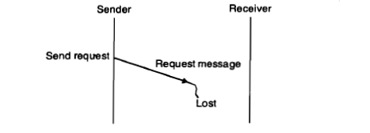
Request message is lost

Slide 55
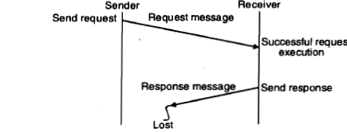
Response message is lost

Slide 56
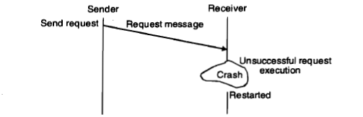
Receiver's computer crashed

Slide 57
To cope with these problems:
A reliable IPC protocol of a message-passing system is designed based on the idea of
internal retransmissions of messages after timeouts and
the return of an acknowledgment message to the sending machine's kernel by the receiving machine's kernel.
Kernel of the sending machine is responsible for retransmitting the message after waiting for a timeout period if no acknowledgment is received from the receiver's machine within this time.
The kernel of the sending machine frees the sending process only when the acknowledgment is received.
The time duration for which the sender waits before retransmitting the request is slightly more than the approximate round-trip time between the sender and the receiver nodes plus the average time required for executing the request.

Slide 58
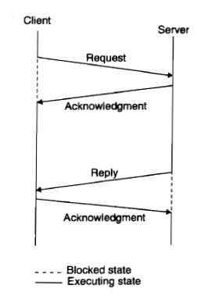
Four-message IPC protocol for client-server communication

Slide 59
The client sends a request message to the server.
When the request message is received at the server's machine, the kernel of that machine returns an acknowledgment message to the kernel of the client machine.
If the acknowledgment is not received within the timeout period, the kernel of the client machine retransmits the request message.
When the server finishes processing the client's request, it returns a reply message (containing the result of processing) to the client.
When the reply message is received at the client's machine, the kernel of that machine returns an acknowledgment message to the kernel of the server machine.
If the acknowledgment message is not received within the timeout period, the kernel of the server machine retransmits the reply message.

Slide 60
Limitations
Problem occurs if a request processing takes a long time.
If the request message is lost, it will be retransmitted only after the timeout period, which has been set to a large value to avoid unnecessary retransmissions of the request message.
If the timeout value is not set properly, long time is needed for request processing and unnecessary retransmissions of the request message will take place.

Slide 61
SOLUTION
The client sends a request message to the server.
When the request message is received at the server's machine, the kernel of that machine starts a timer.
If the server finishes processing the client's request and returns the reply message to the client before the timer expires, the reply serves as the acknowledgment of the request message.
Otherwise, a separate acknowledgment is sent by the kernel of the server machine to acknowledge the request message.
If an acknowledgment is not received within the timeout period, the kernel of the client machine retransmits the request message.
When the reply message is received at the client's machine, the kernel of that machine returns an acknowledgment message to the kernel of the server machine.
If the acknowledgment message is not received within the timeout period, the kernel of the server machine retransmits the reply message.

Slide 62
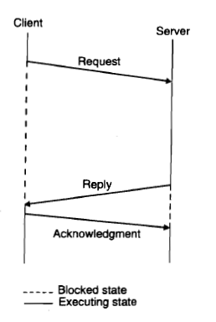
Three-message IPC protocol for client-server communication

Slide 63
The client sends a request message to the server.
When the server finishes processing the client's request, it returns a reply message (containing the result of processing) to the client.
The client remains blocked until the reply is received.
If the reply is not received within the timeout period, the kernel of the client machine retransmits the request message.
When the reply message is received at the client's machine, the kernel of that machine returns an acknowledgment message to the kernel of the server machine.
If the acknowledgment message is not received within the timeout period, the kernel of the server machine retransmits the reply message.

Slide 64
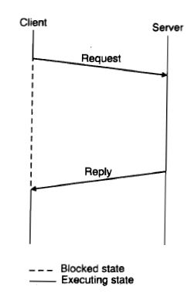
Two-message IPC protocol for client-server communication

Slide 65
The client sends a request message to the server and remains blocked until a reply is received from the server.
When the server finishes processing the client's request, it returns a reply message (containing the result of processing) to the client.
If the reply is not received within the timeout period, the kernel of the client machine retransmits the request message.

Slide 66
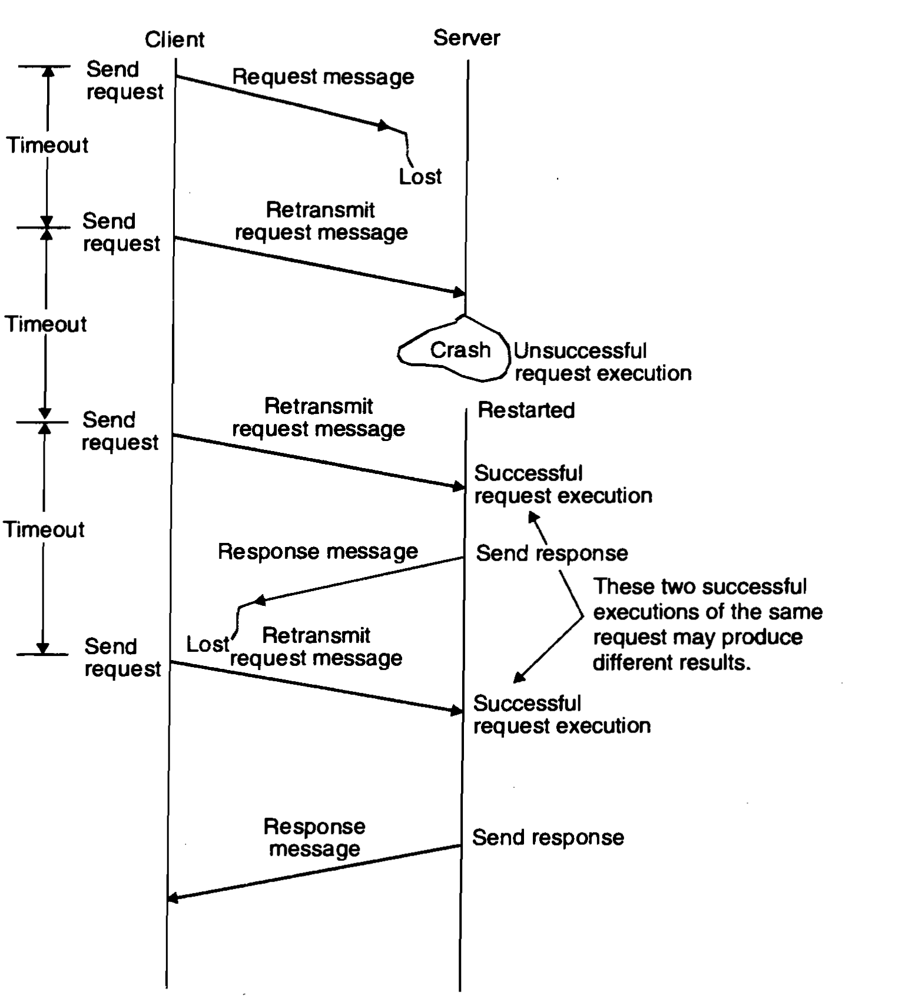
Fault-tolerant communication between client- server

